Slide 1

Cyber Defense Organization
Fall 2018 Debrief

Slide 2
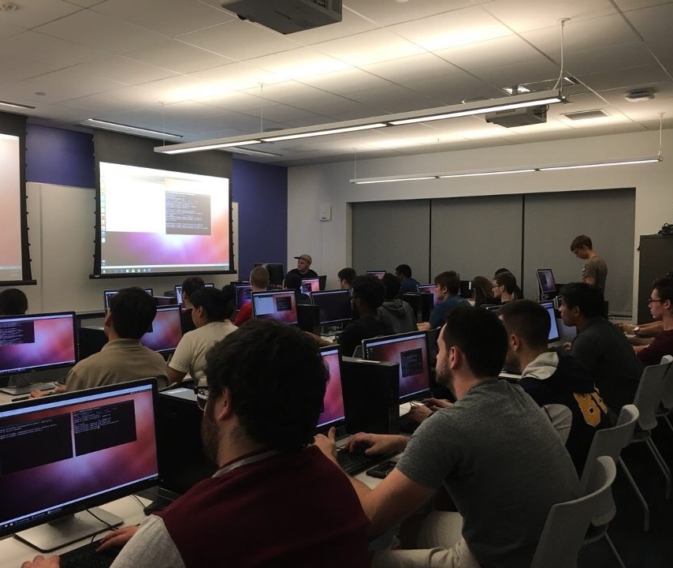
We Are the Cyber Defense Organization
Sharing Practical Skills for Practical Situations. Our purpose is to help train students in the fundamentals of cybersecurity, and train for different competitions such as CCDC and other local events.

Slide 3
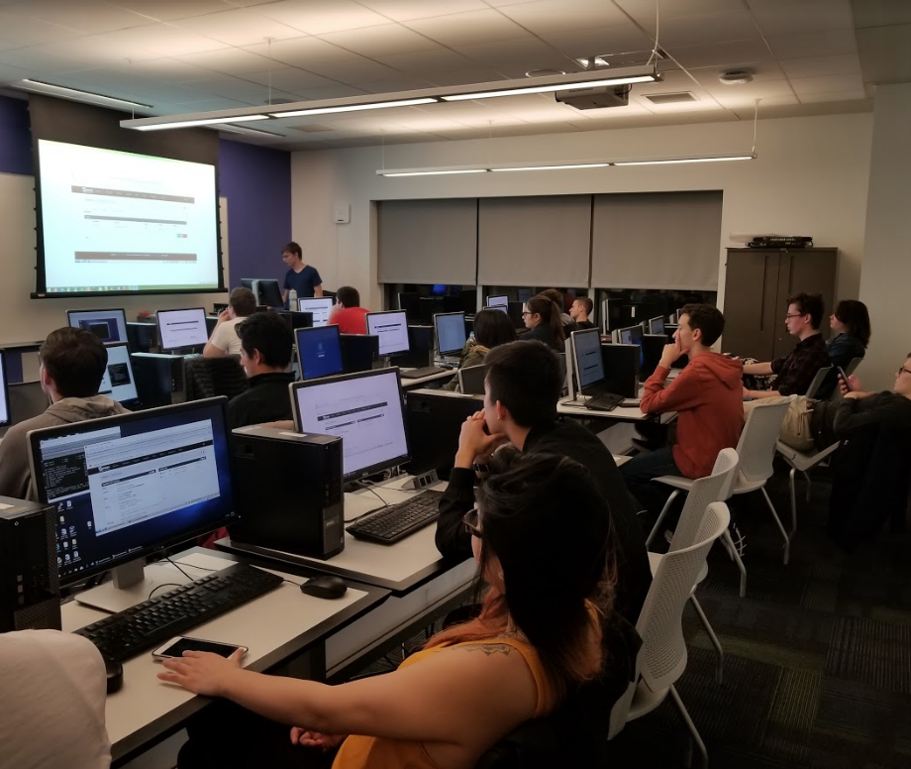
Workshops
Every week we hope to introduce a technical topic related to cybersecurity and have you work with it.

Slide 4



~Competitions

Slide 5
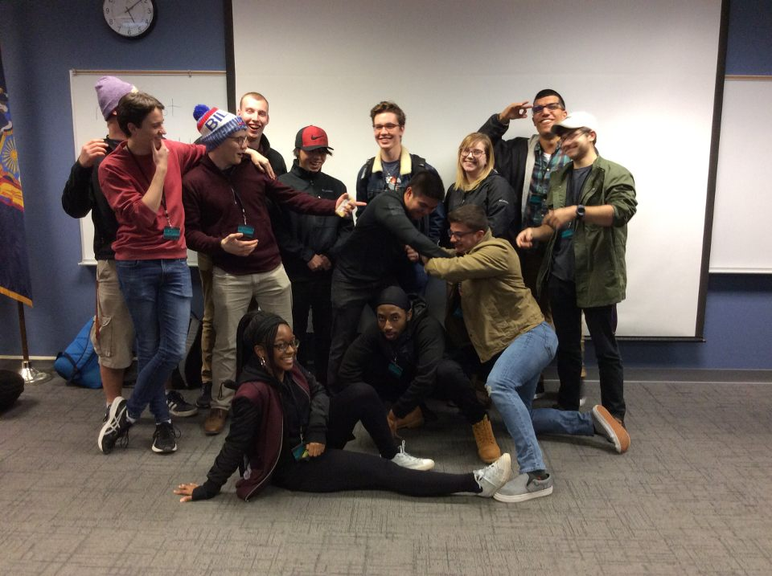
~CNY HACKATHON - 13 Members
Max Kirby - Most Improved
Ally Beerle
Andrew Willman - MVP
Andrew Sussmann
Elvis Gadtaula
Noah Beadle - Most Improved
Daunte Kinsey
Liam Smith
Sarah Granston
Scott Bush
Anthony Capece III - MVP
Tyler Blanco
Mike Mieses - Most Improved

Slide 6
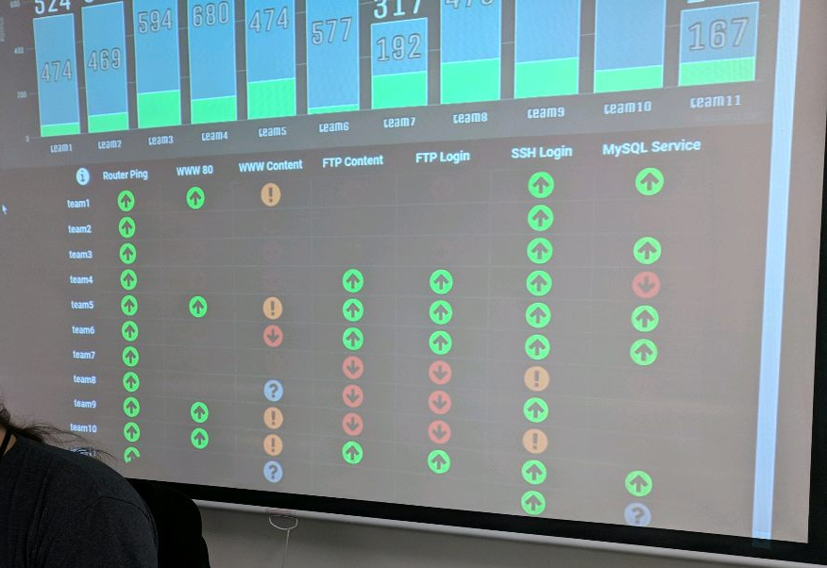
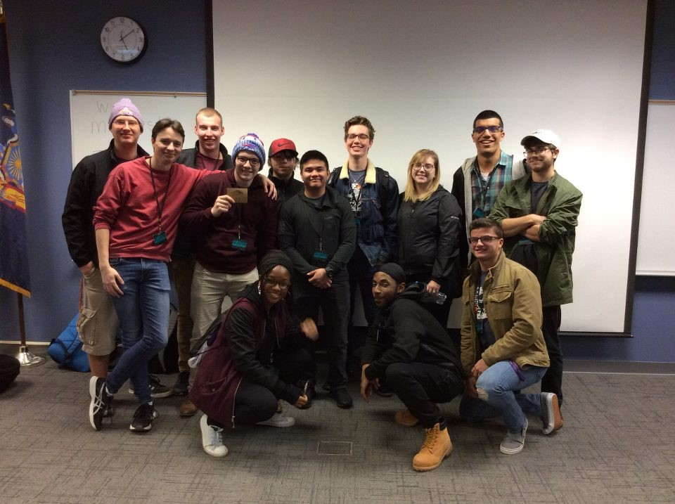
~CNY HACKATHON

Slide 7
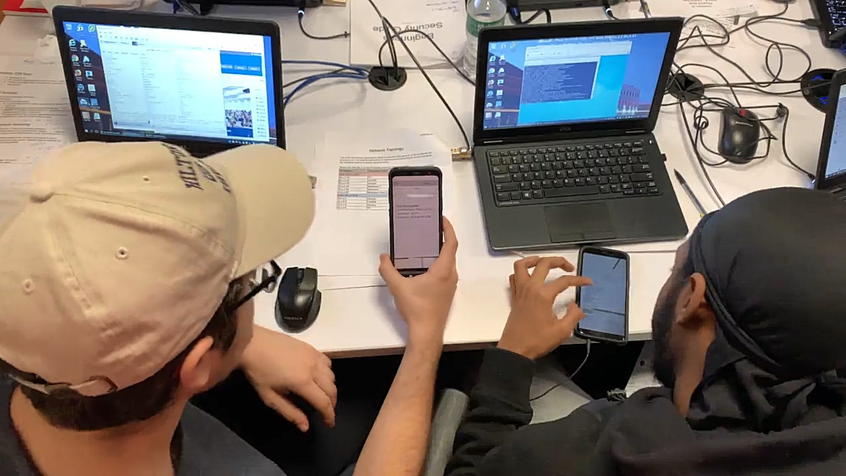
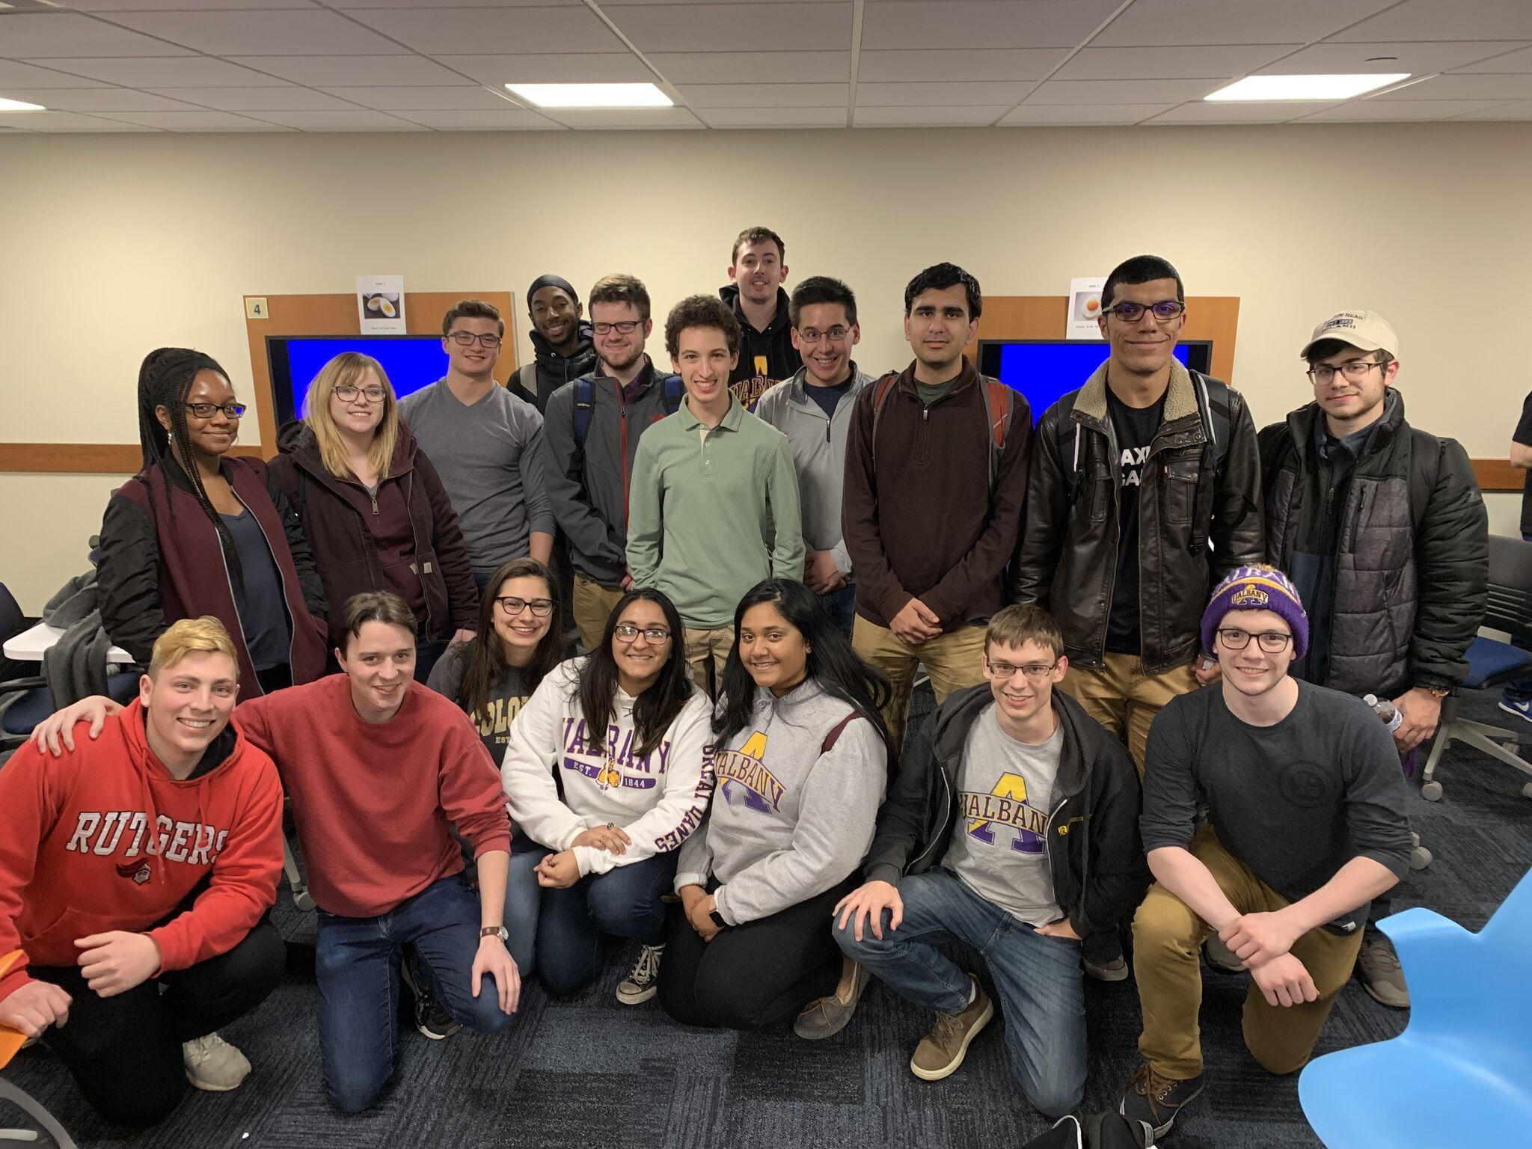
UBNETDEF V5 - Buffalo, NY
~/18 Members for Red vs Blue competition
~/Sent two teams

Slide 8
~Member Growth
-2016 Cyber Defense Organization was created
~ 20 members
~ 7-10 person average attendance
~ Monthly Workshop
~ One competition/year
2018
~ 220 Members
~ 35 Person Average Attendance
~ Weekly Workshop
~ 6 Competitions/year
We keep growing
-

Slide 9
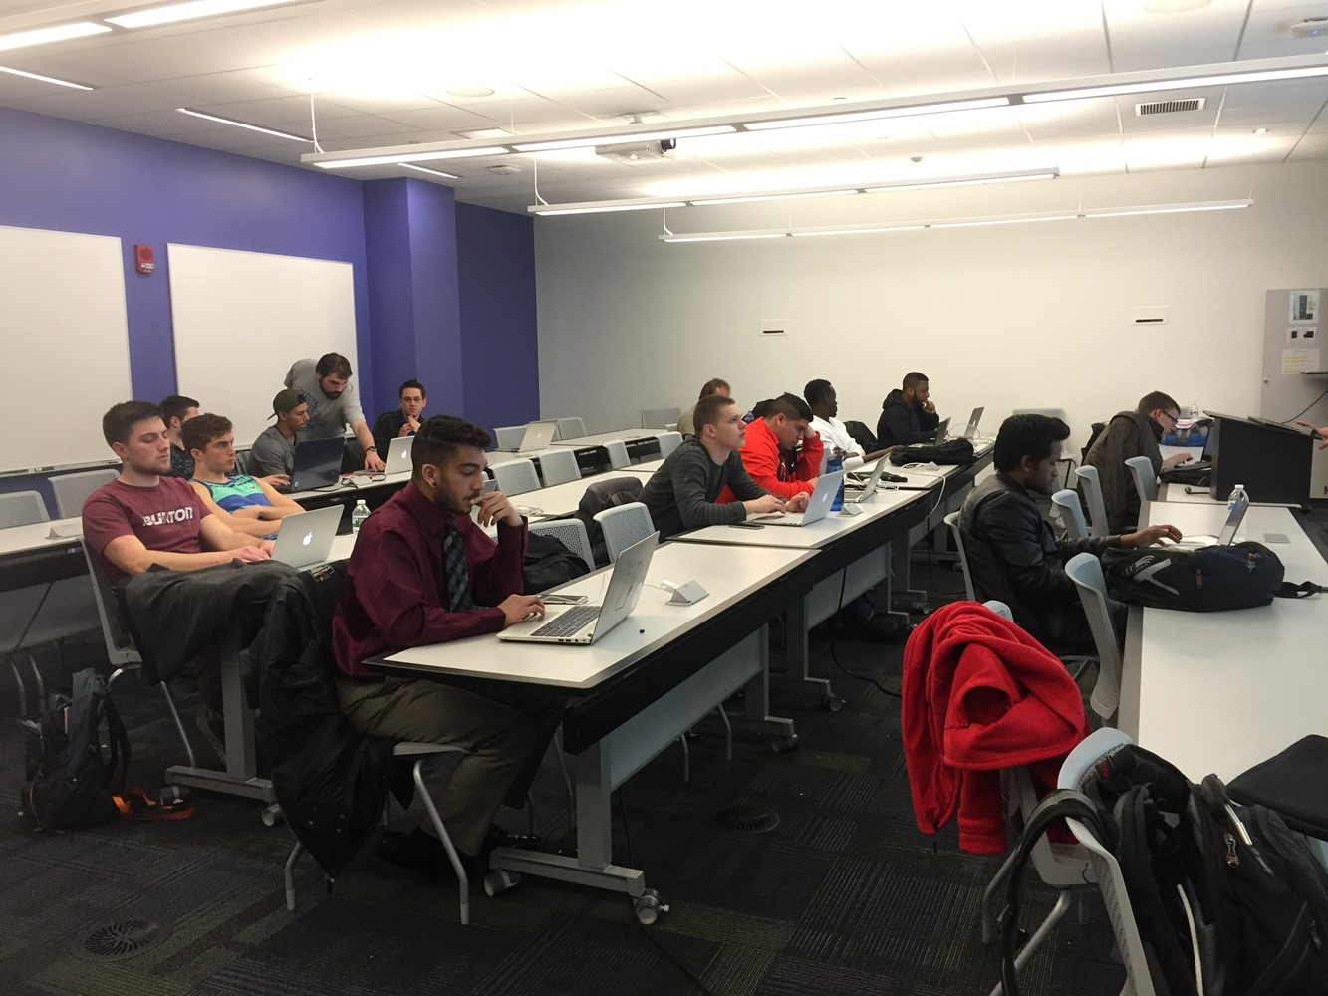
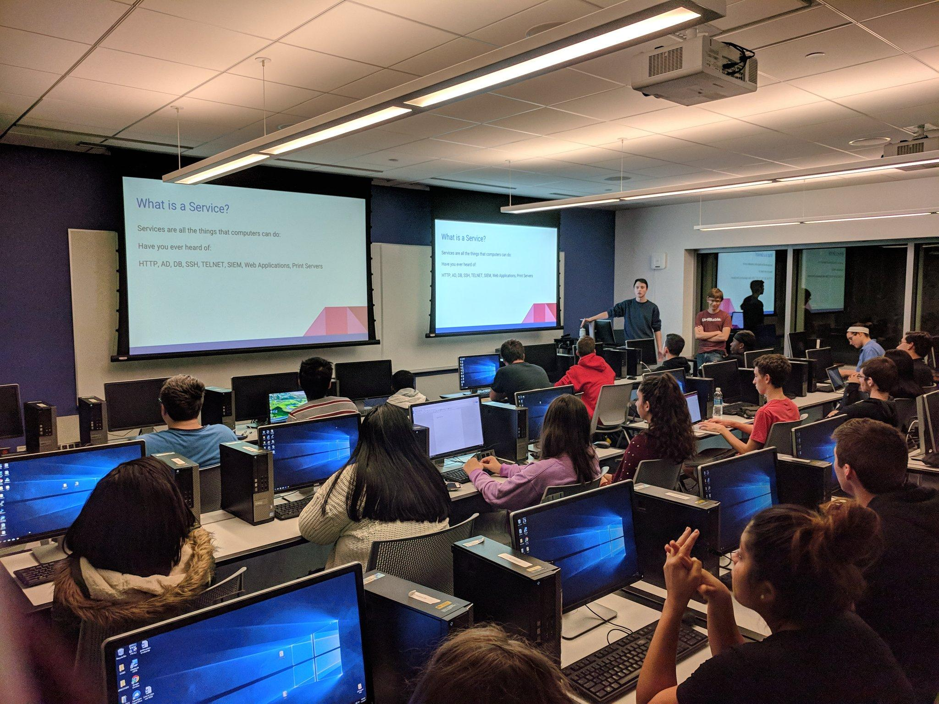
~Member Growth
2016 ~ 7-10 average attendance 2018 ~ 35 average attendance
-

Slide 10
Whats next? - Server
Purchased Server
Infrastructure for members to train
Host competitions (red vs blue)
Head to head competitions
Provide members a environment to learn / train
Build machine -> Destroy them
Possibilities endless

Slide 11
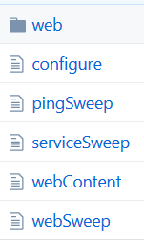
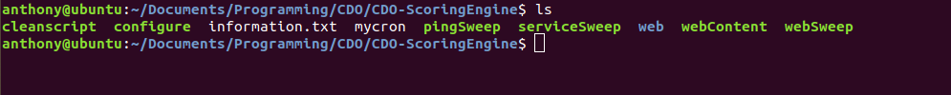
Whats next? - Internal Competitions
Building scoring engine for internal red vs blue
Andrew Willman & Anthony C
Devs, If you are interested hit us up - Especially PHP & HTML

Slide 12

Whats next? - Red vs Blue Competitions
Collegiate Cyber Defense Competition
12 Members total
In Vermont this year - March 15-17, 2019
Qualifier in JANUARY
More on NECCDC2019 -- www.neccdc2019.org

Slide 13

Whats next? - Red vs Blue Competitions
CNY 2019
UBNetDef v6 !!!
And MANY More we are currently looking to get a team to compete in.

Slide 14
Whats next? - Workshops
Physical Security
More on AWS
Penetration Testing
Malware?
Member’s get involved!

Slide 15
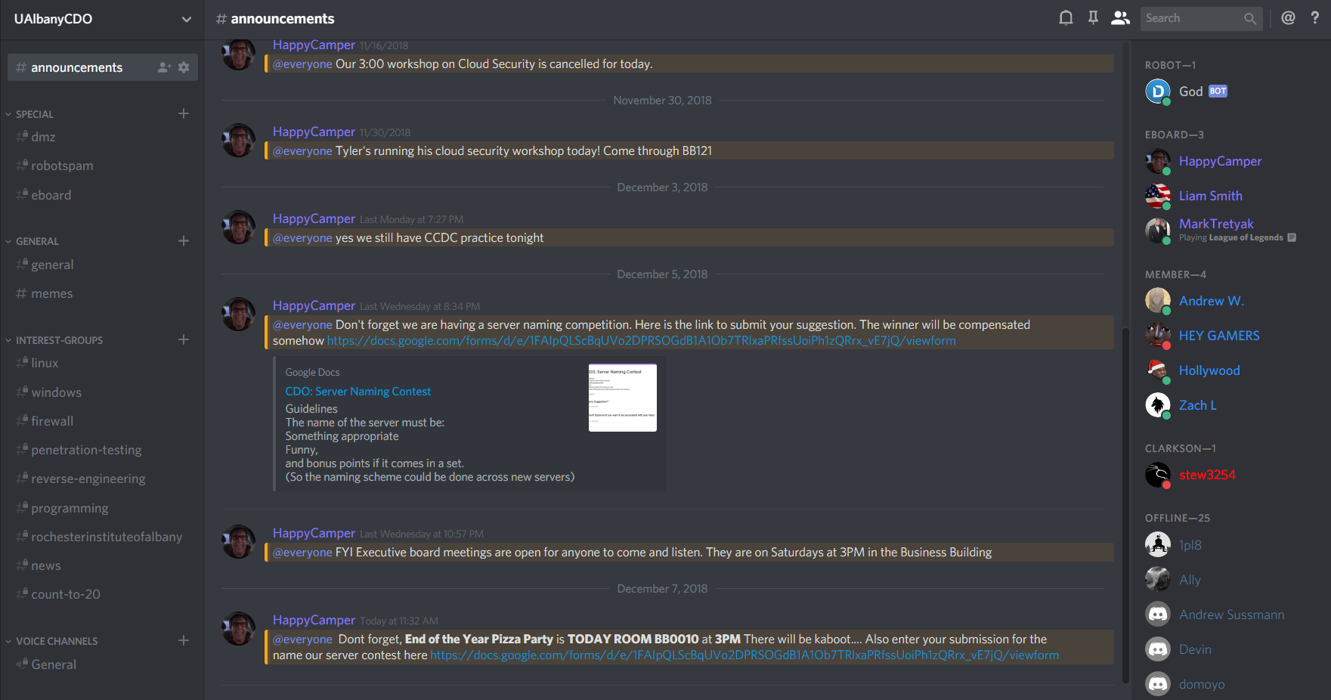
Social Media/Community
Join the discord!
https://discord.gg/57k8Vg
Club Updates
Interest Groups
Training Material
Get help with projects

Slide 16

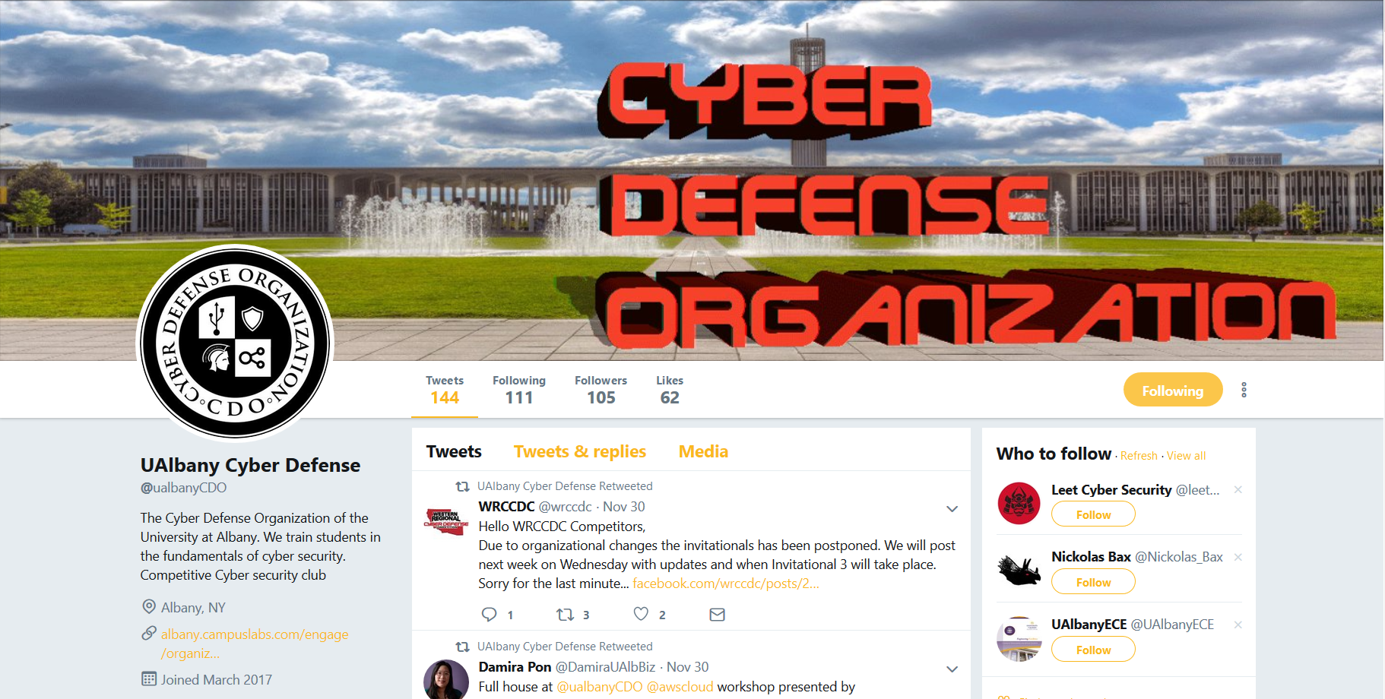
Social Media/Community
Follow the twitter

Slide 17
Major Accomplishments
Finally got that Server
The most amount of people interested for competitions ever.
Most active semester by far for the organization in terms of weekly meetings.

Slide 18
Server Naming
Put in suggestions ASAP VOTING AFTER!
>> https://goo.gl/k3ngBE

Slide 19
Thank you - Feedback
What do you guys want to see?
Event ideas, etc
Workshop ideas
Meeting Times
Member Presentations
Branding, Tell your friends about CDO. Let's make UAlbany known for CyberSecurity
New Logo too

Slide 20
Eboard Meetings
OPEN TO EVERYONE
USUALLY 3PM every Saturday
Come talk to us! We want your input

Slide 21

Pizza time
Please form a line in the back
Kahoot

